Slide 1


Slide 2
Problem/Solution Overview
Problem:
Political discourse for college educated, politically curious people lacks human element.
Solution:
Enable college educated, politically curious people to connect, share news, and engage in offline conversations.

Slide 3
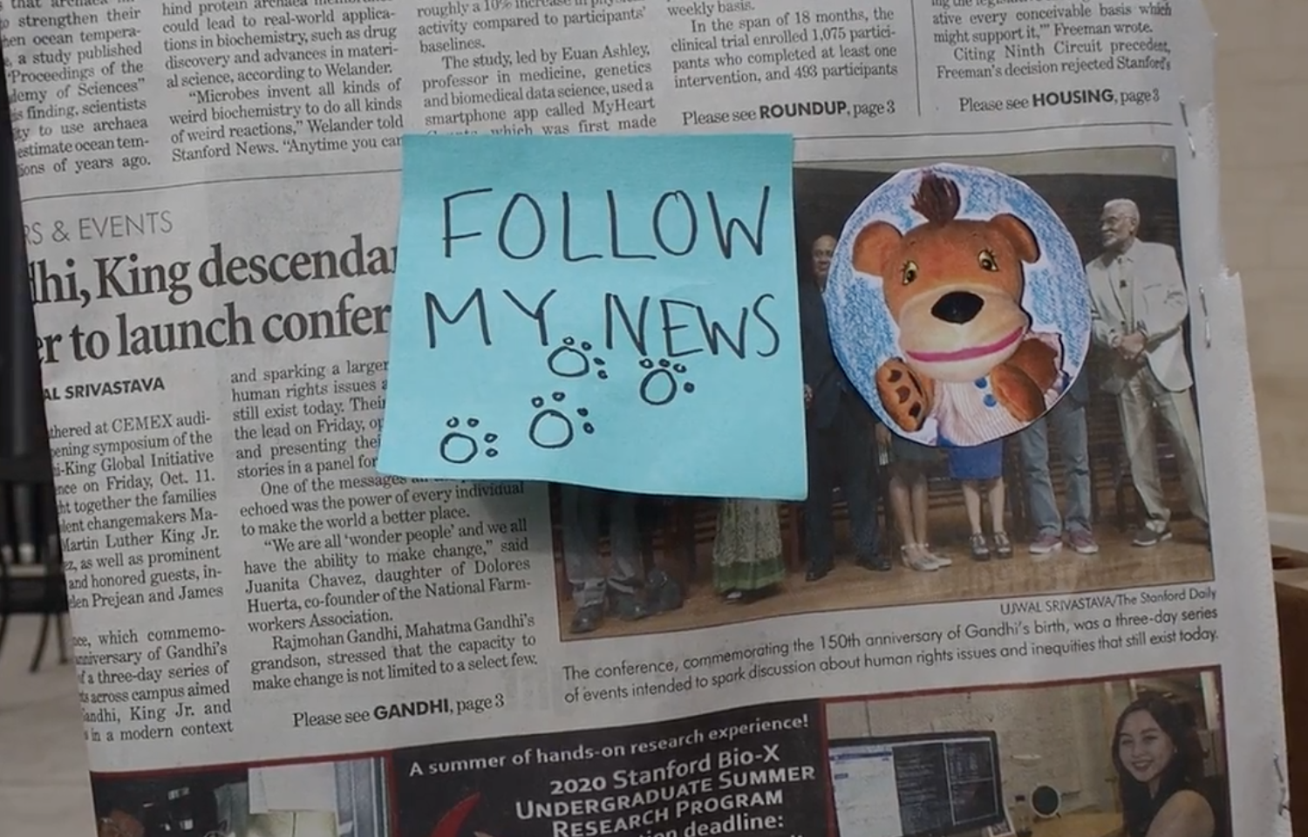
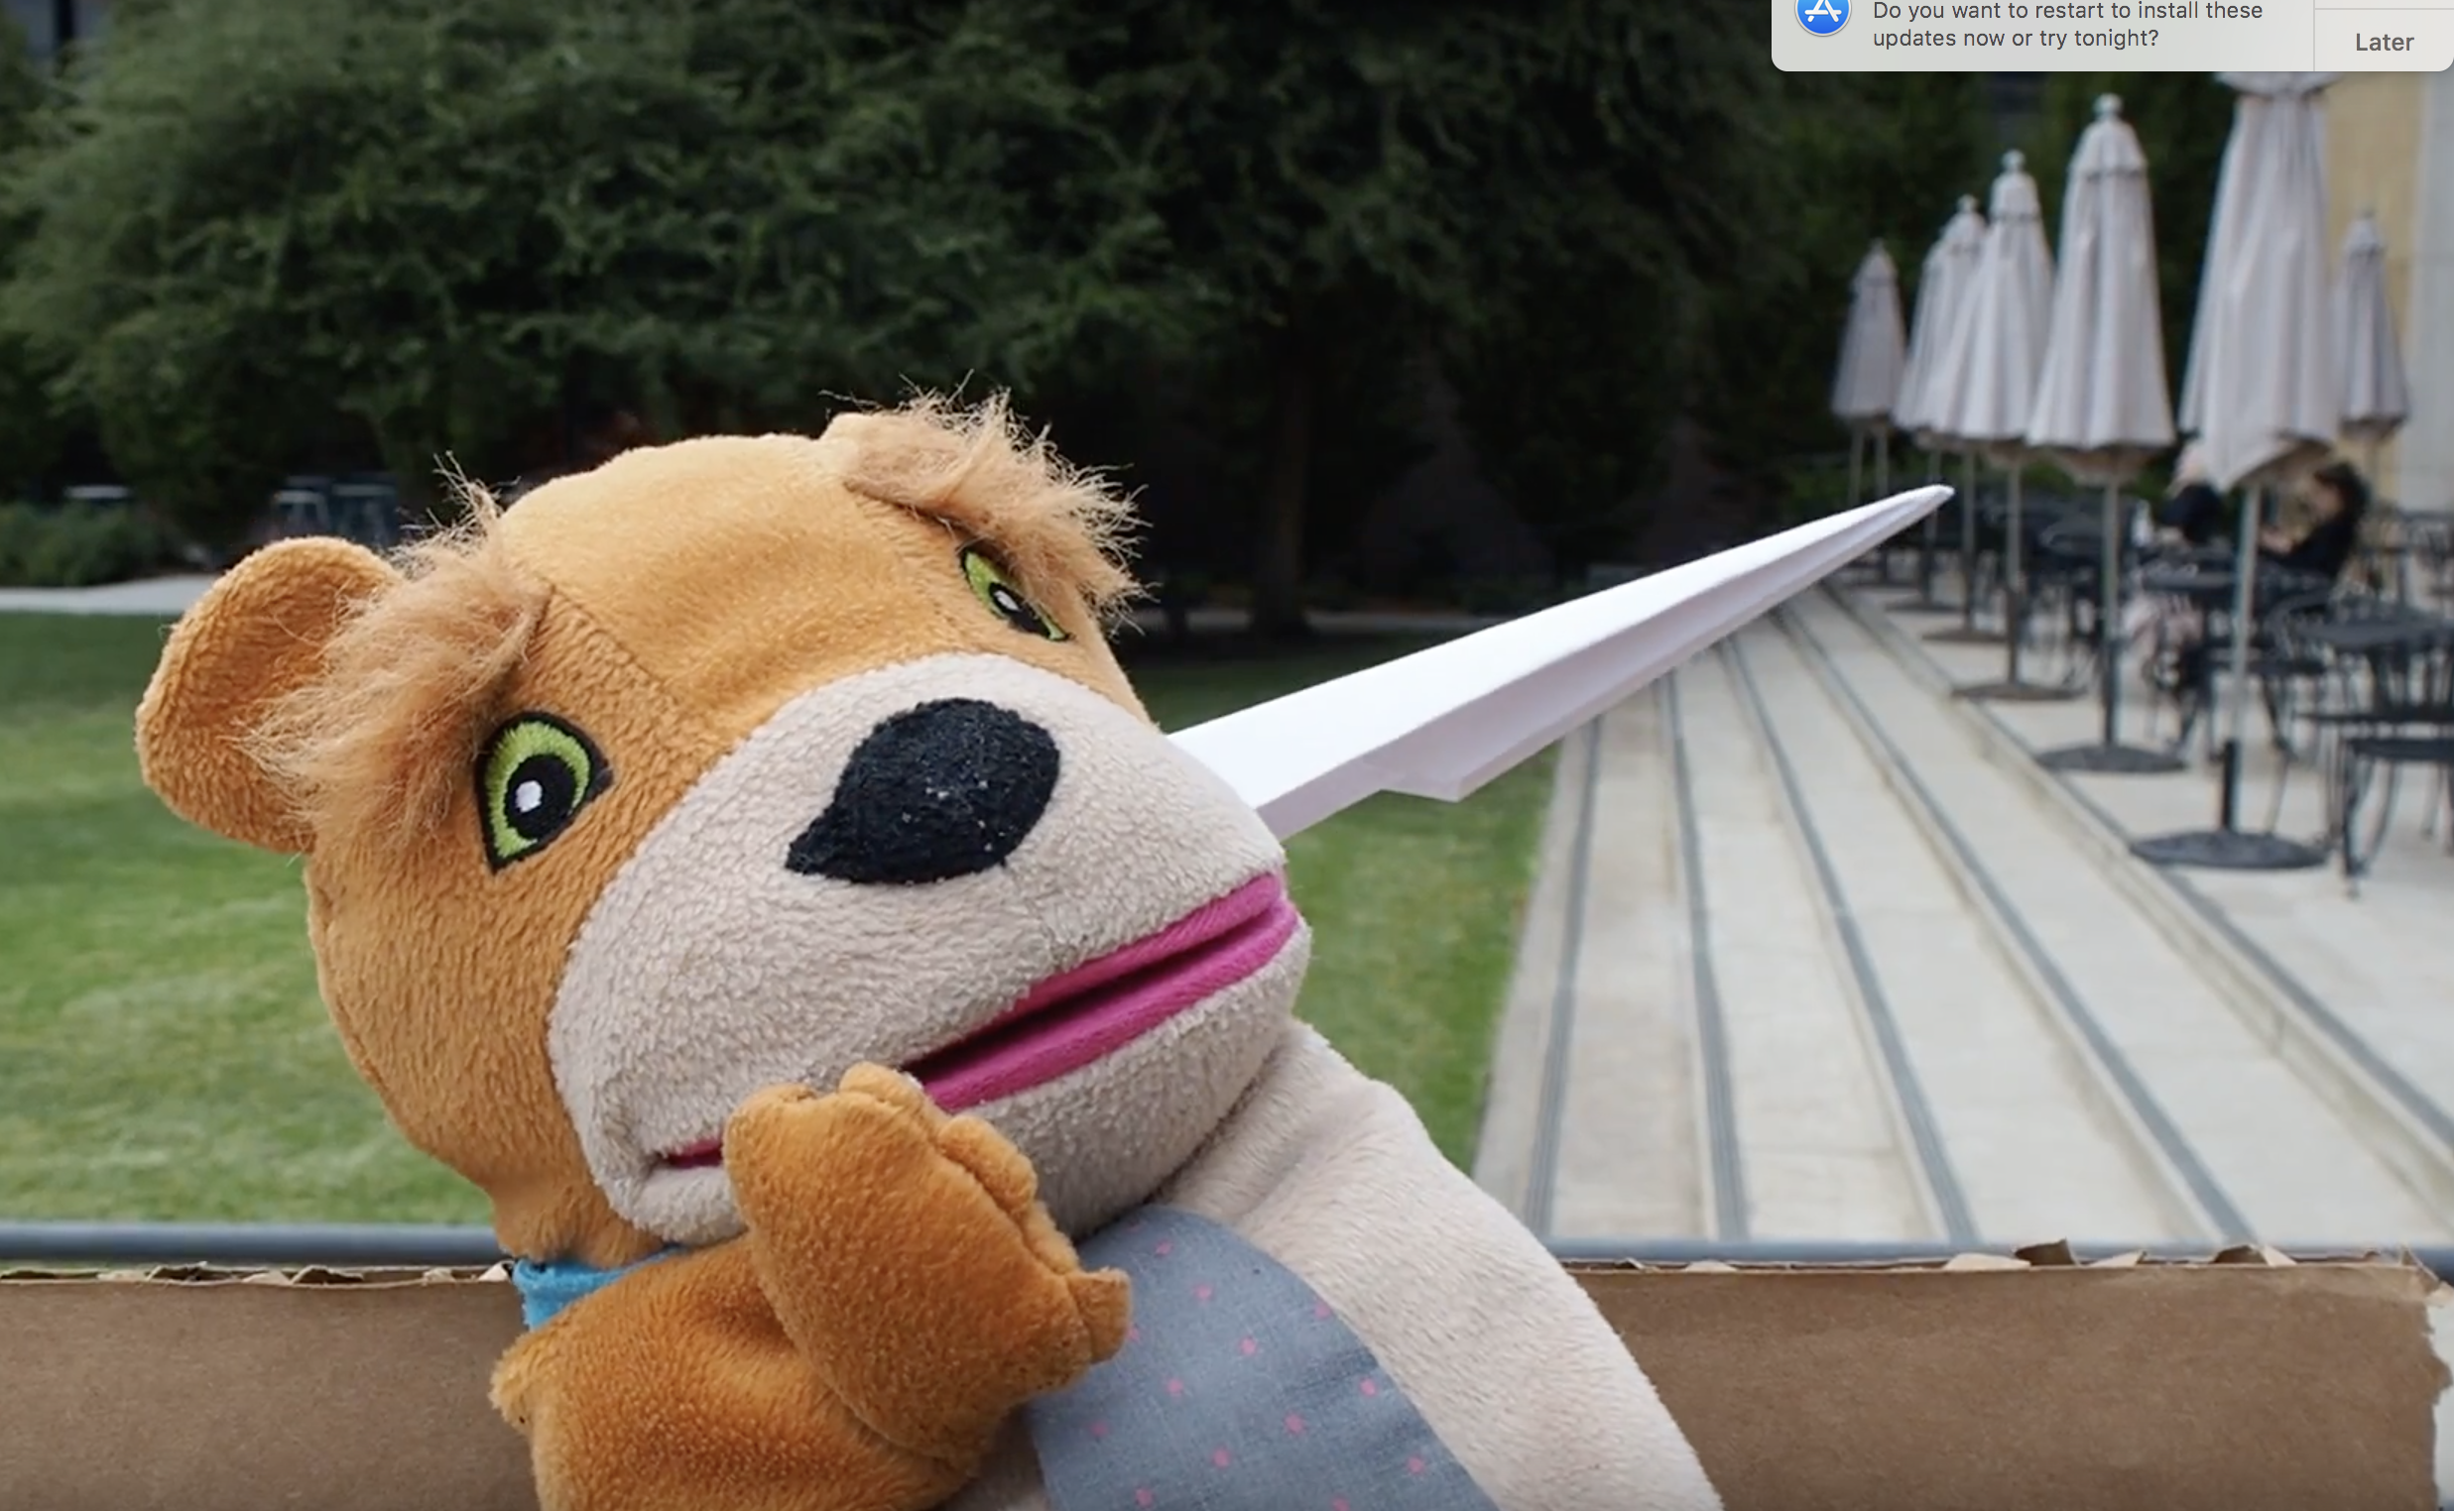
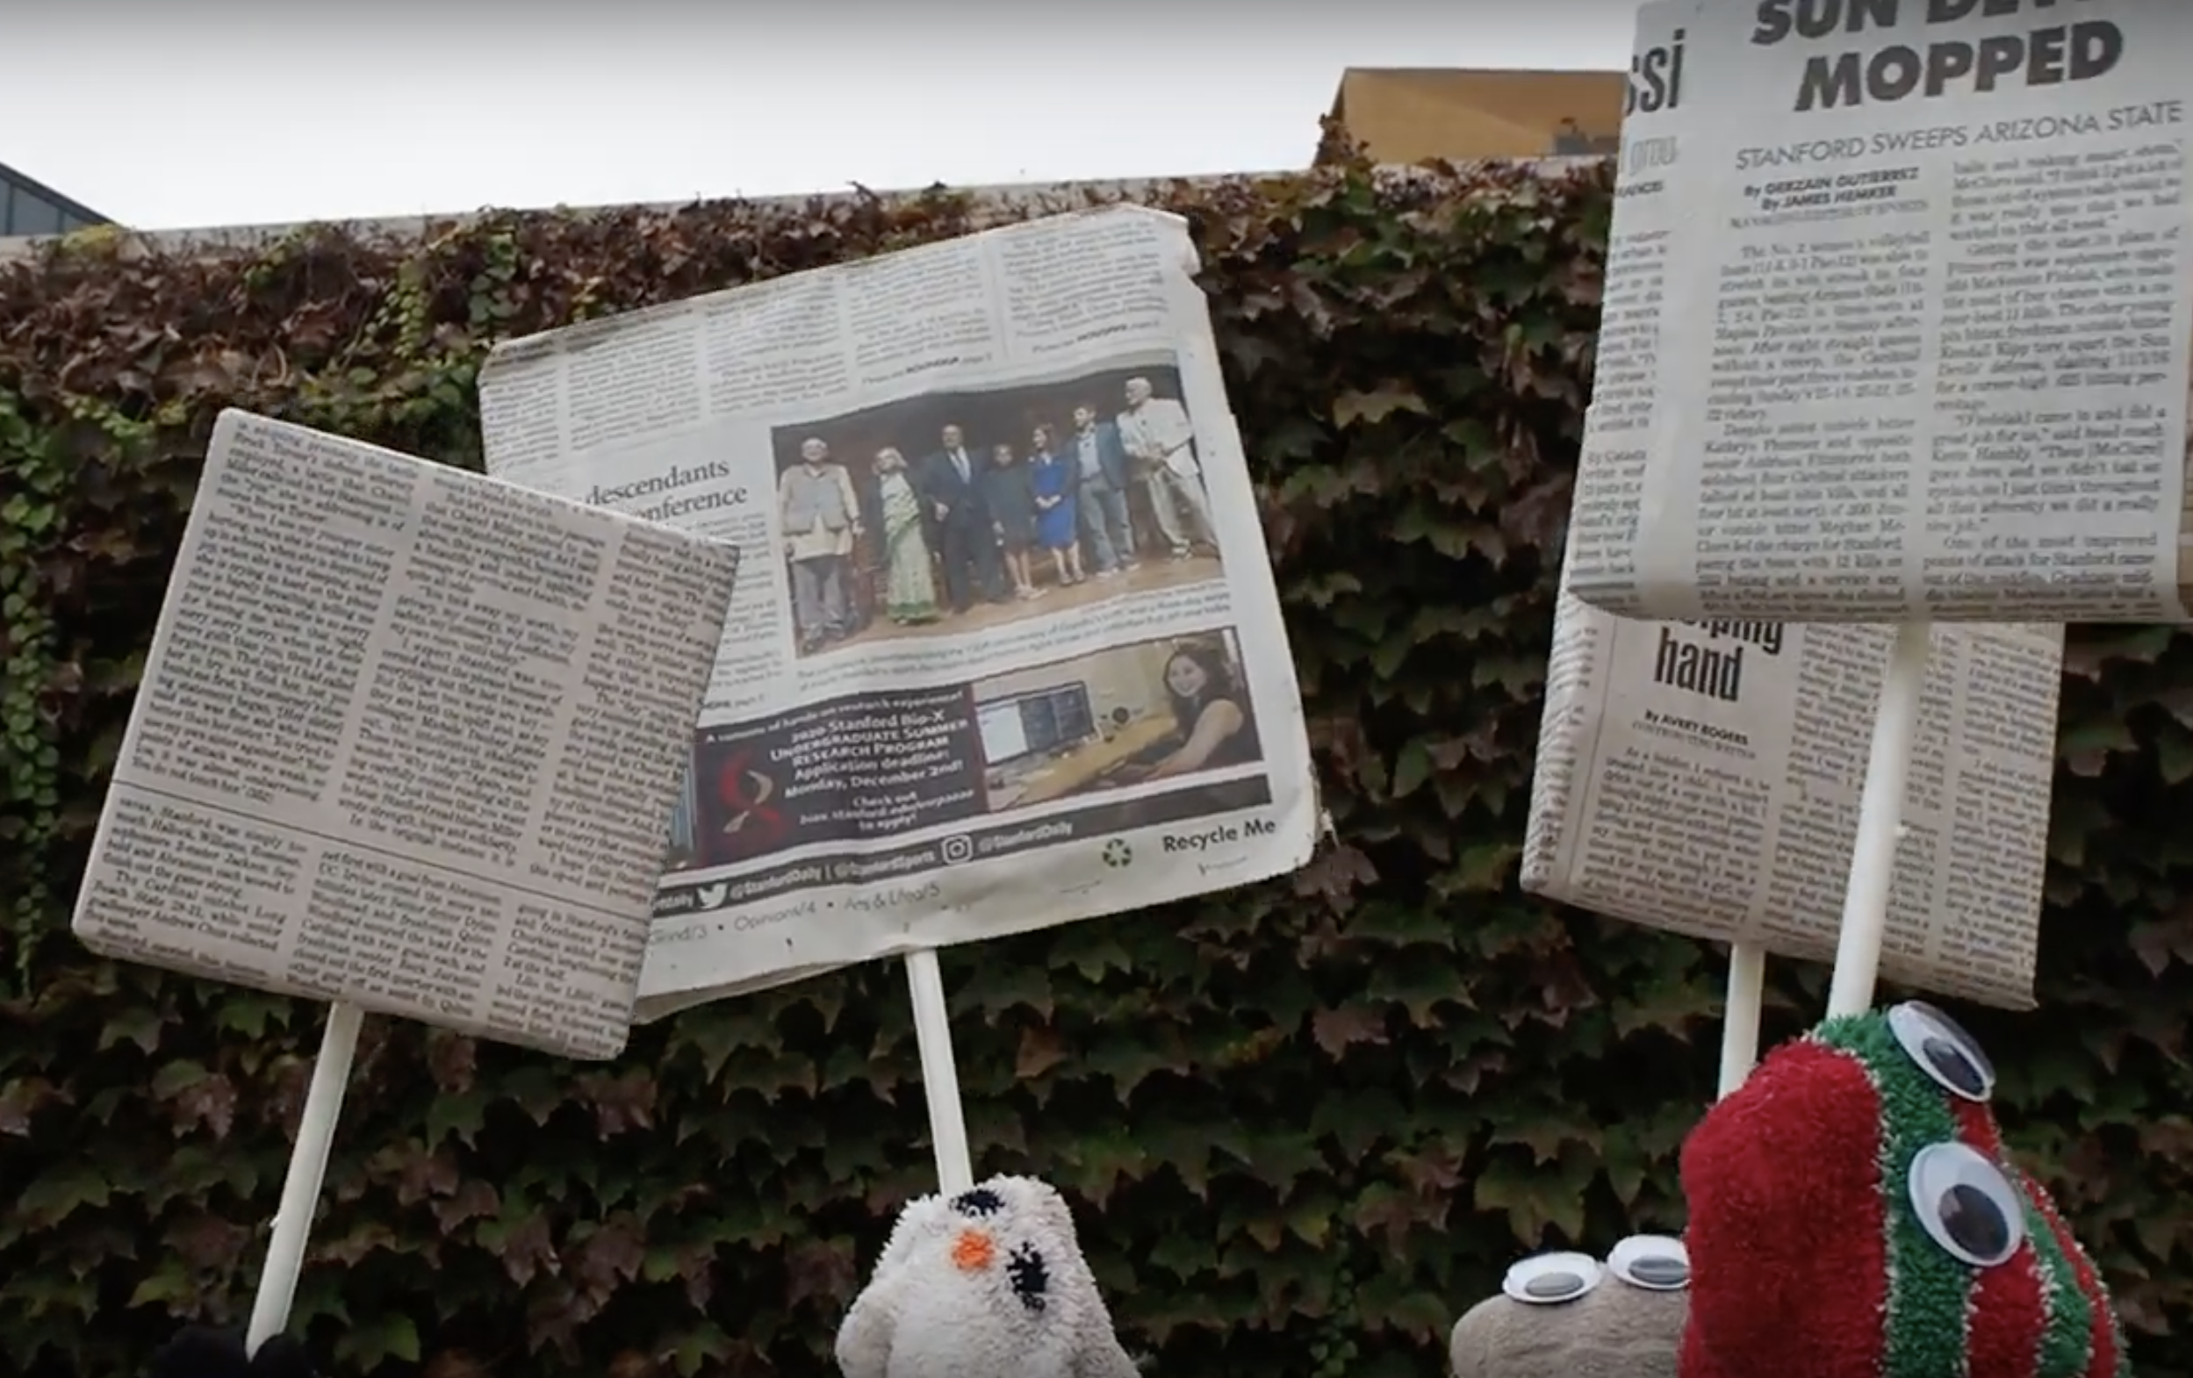
Simple Task: Keep up with other people’s news
Medium Task: Share your news with your friends
Complex Task: Organize political events

Slide 4
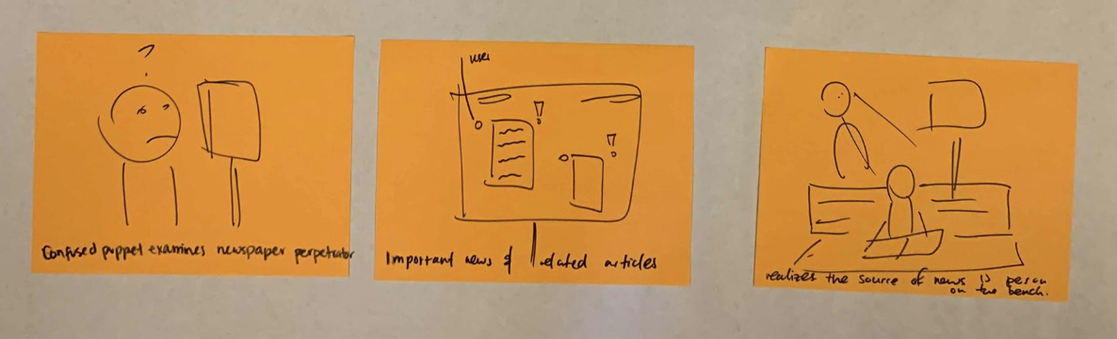
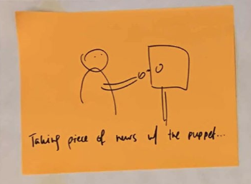
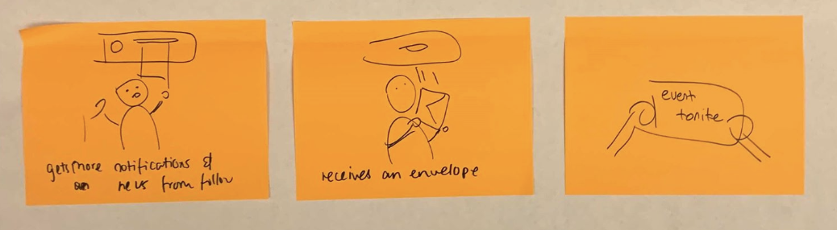
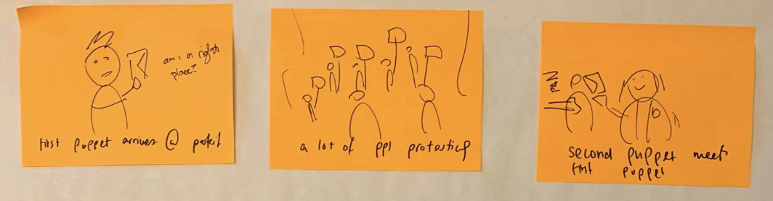
Simple Task: Keep up with other people’s news
Medium Task: Share your news with your friends
Complex Task: Organize political events

Slide 5
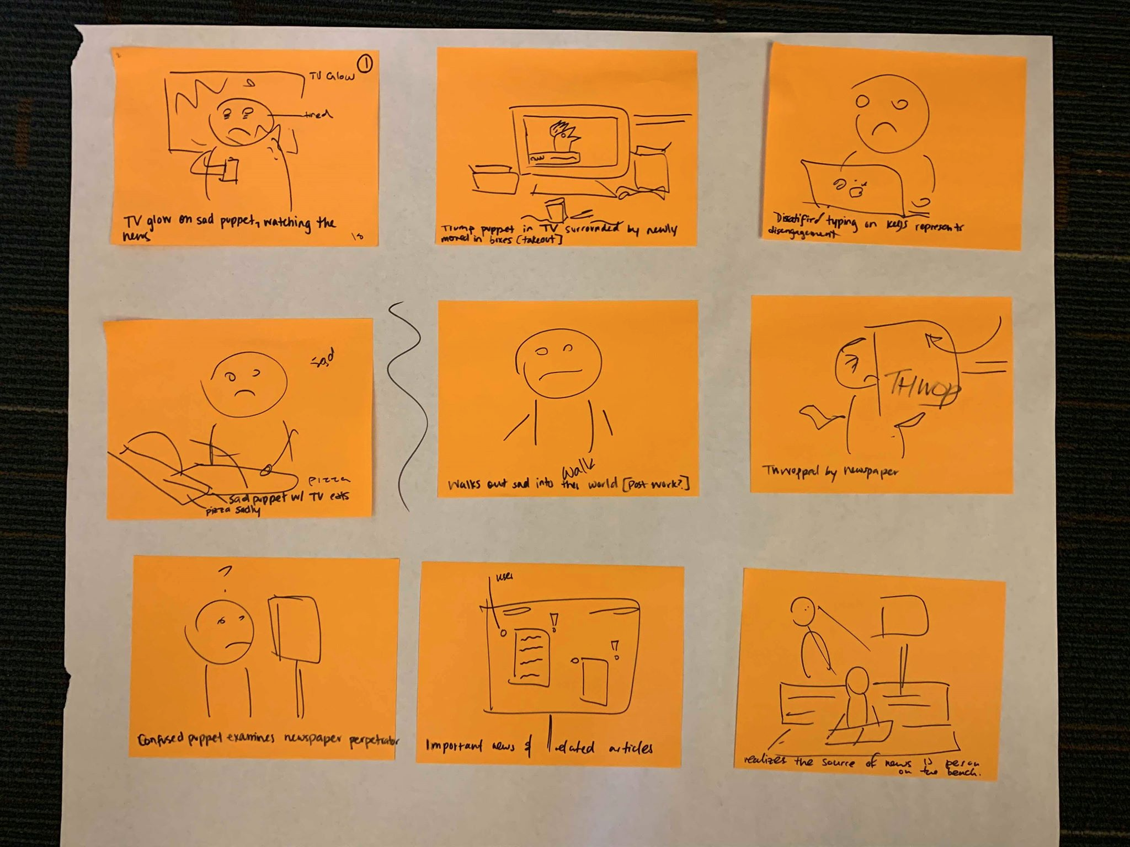
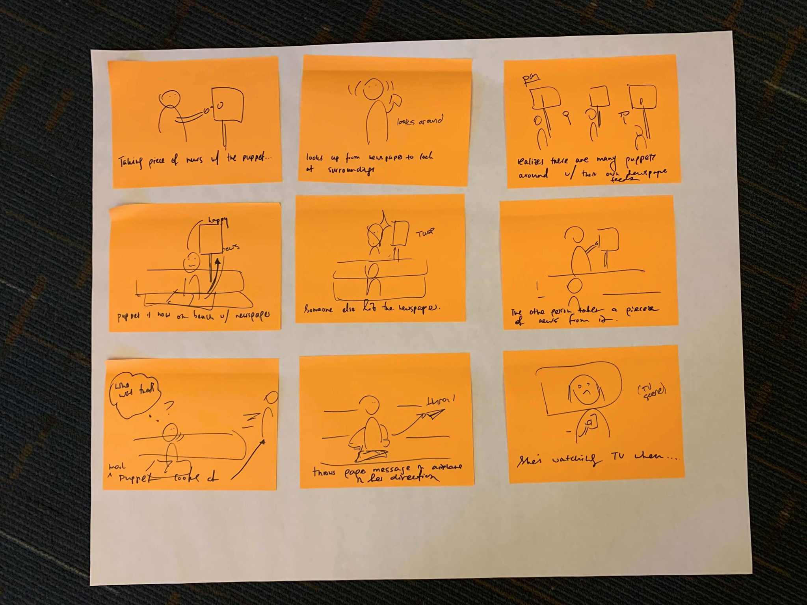
Appendix: Full storyboard

Slide 6
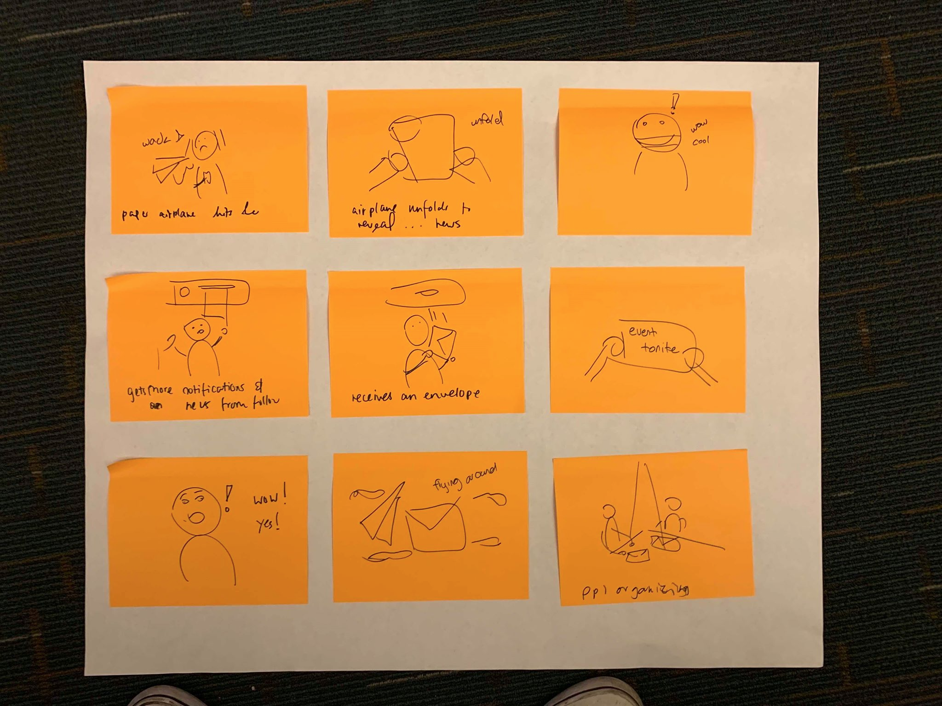
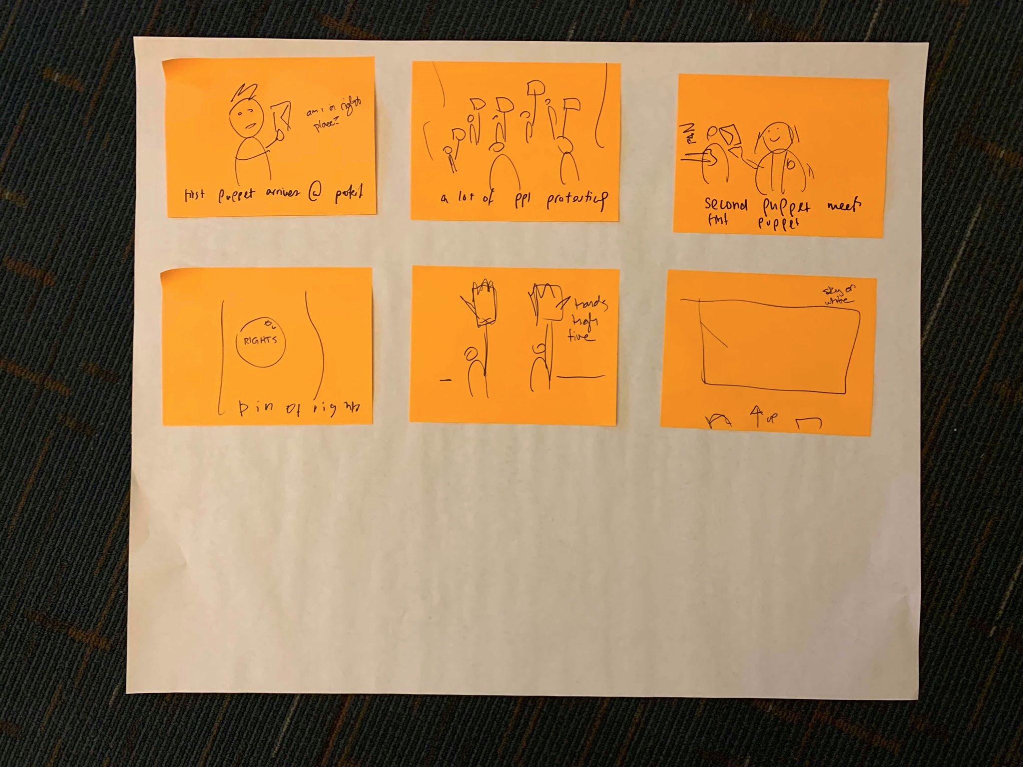
Appendix: Full storyboard (cont.)

